Slide 1
jobject
all java object
jclass
java.lang.Class object
jstring
java.lang.String object
jarray
arrays
jobjectArray
object arrays
jbooleanArray
boolean arrays
jbyteArray
byte arrays
jcharArray
char arrays
jshortArray
short arrays
jintArray
int arrays
jlongArray
long arrays
jfloatArray
float arrays
jdoubleArray
double arrays
jthrowable
java.lang.Throwable object

Slide 2
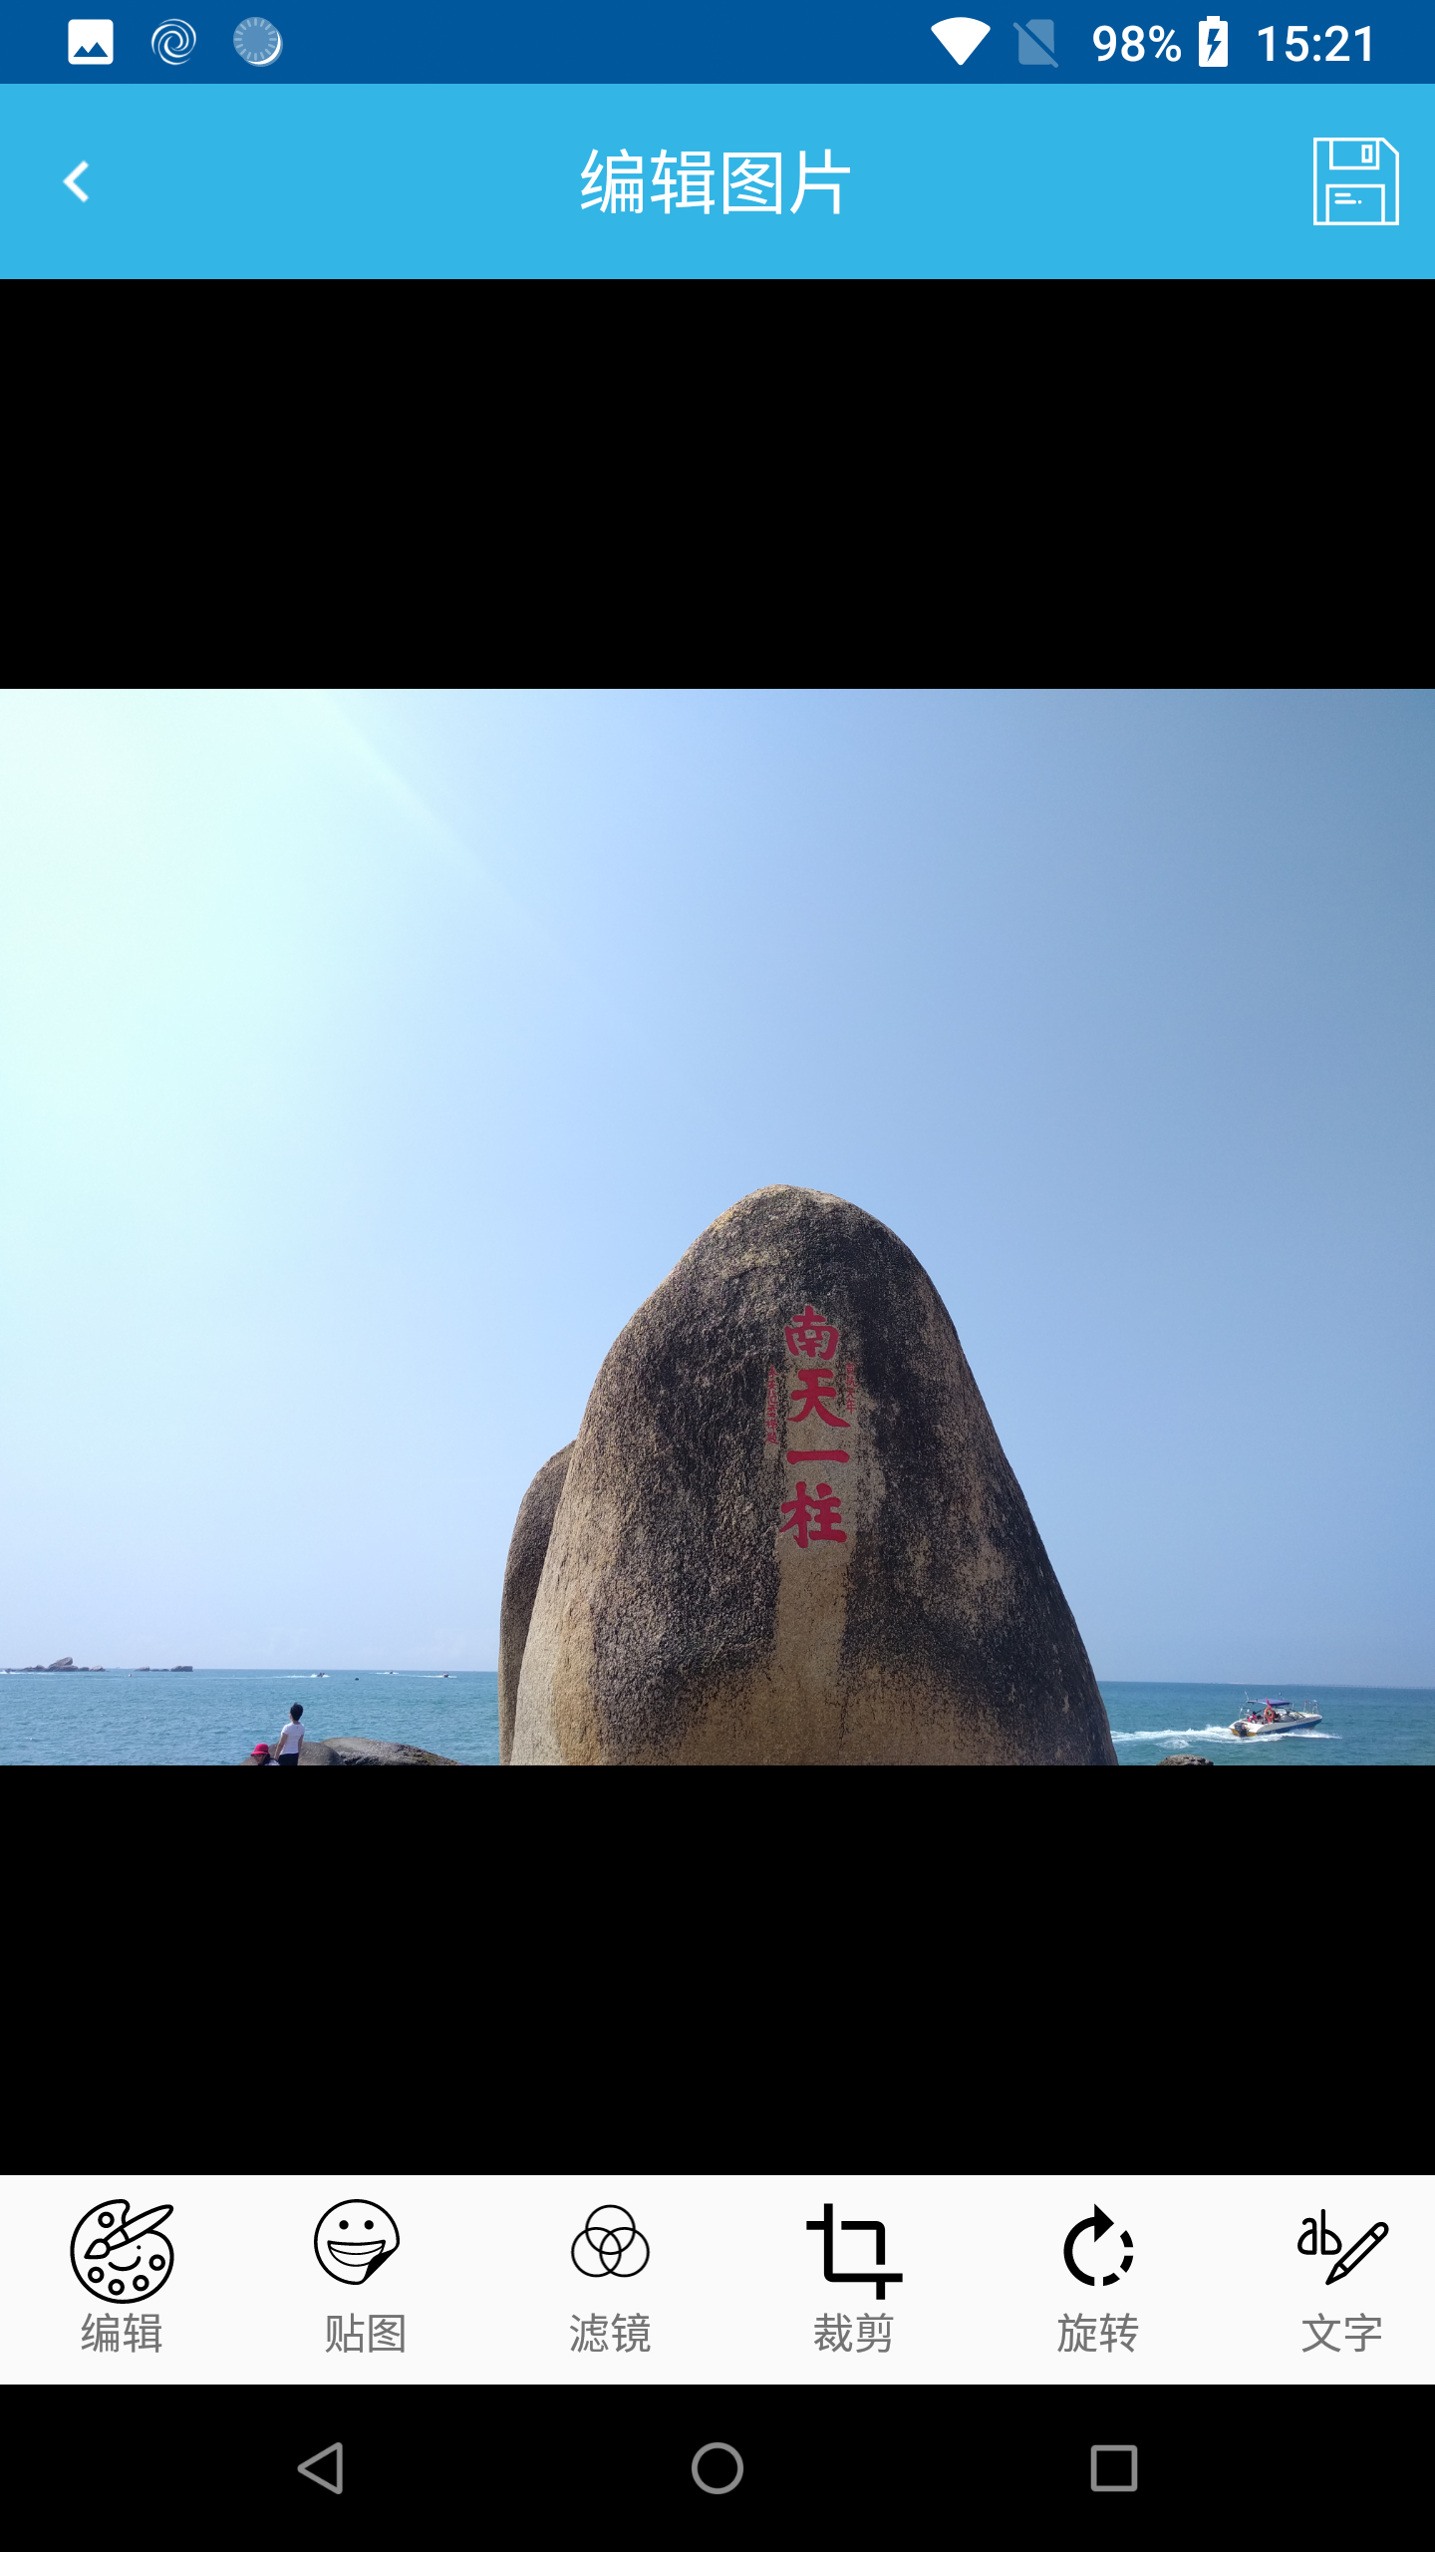

主编辑界面

Slide 3

MainMenuFragment
PaintFragment
StickerFragment
FilterListFragment
CropFragment
RotateFragment
AddTextFragment
EnhanceFragment
FrameFragment

Slide 4
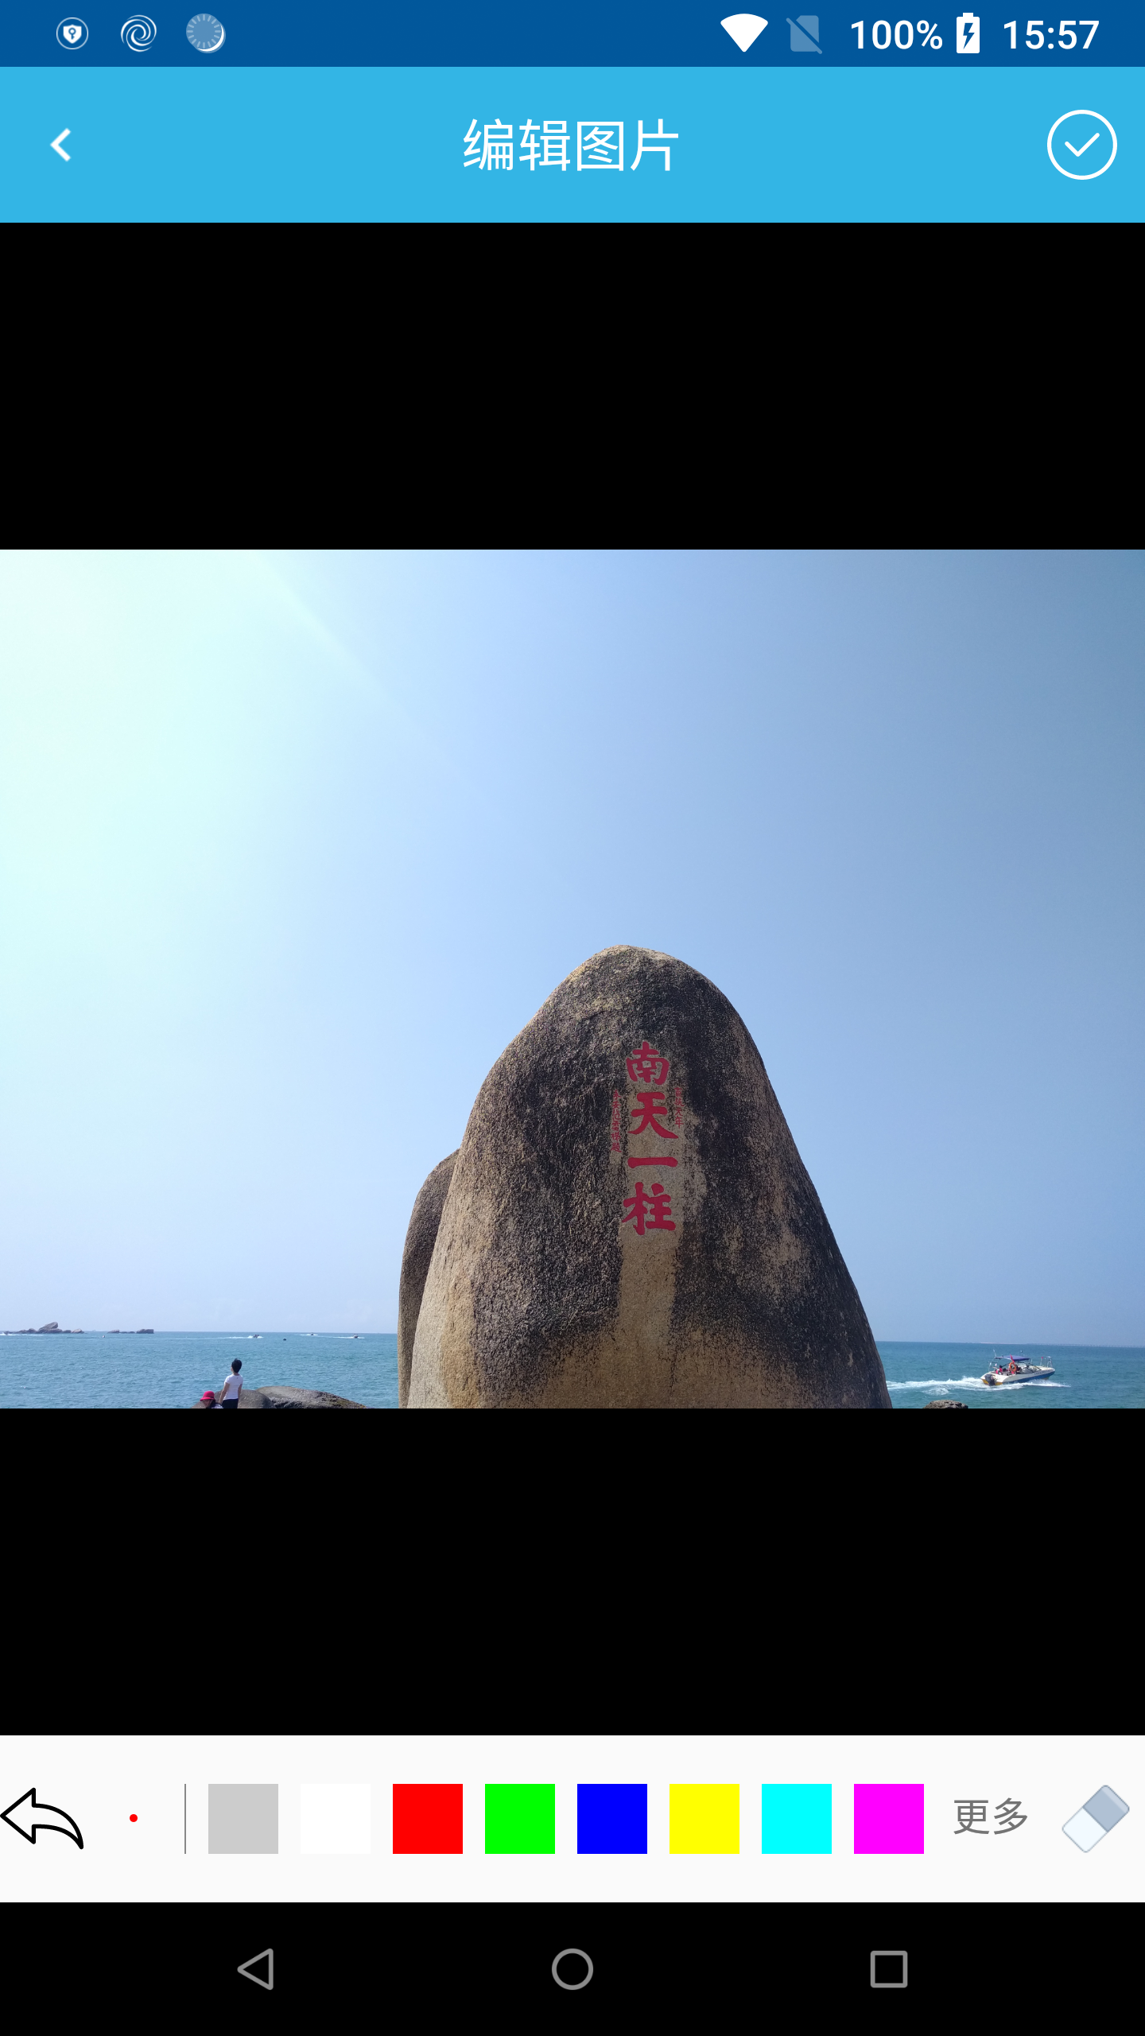
A
B
C
D

Slide 5
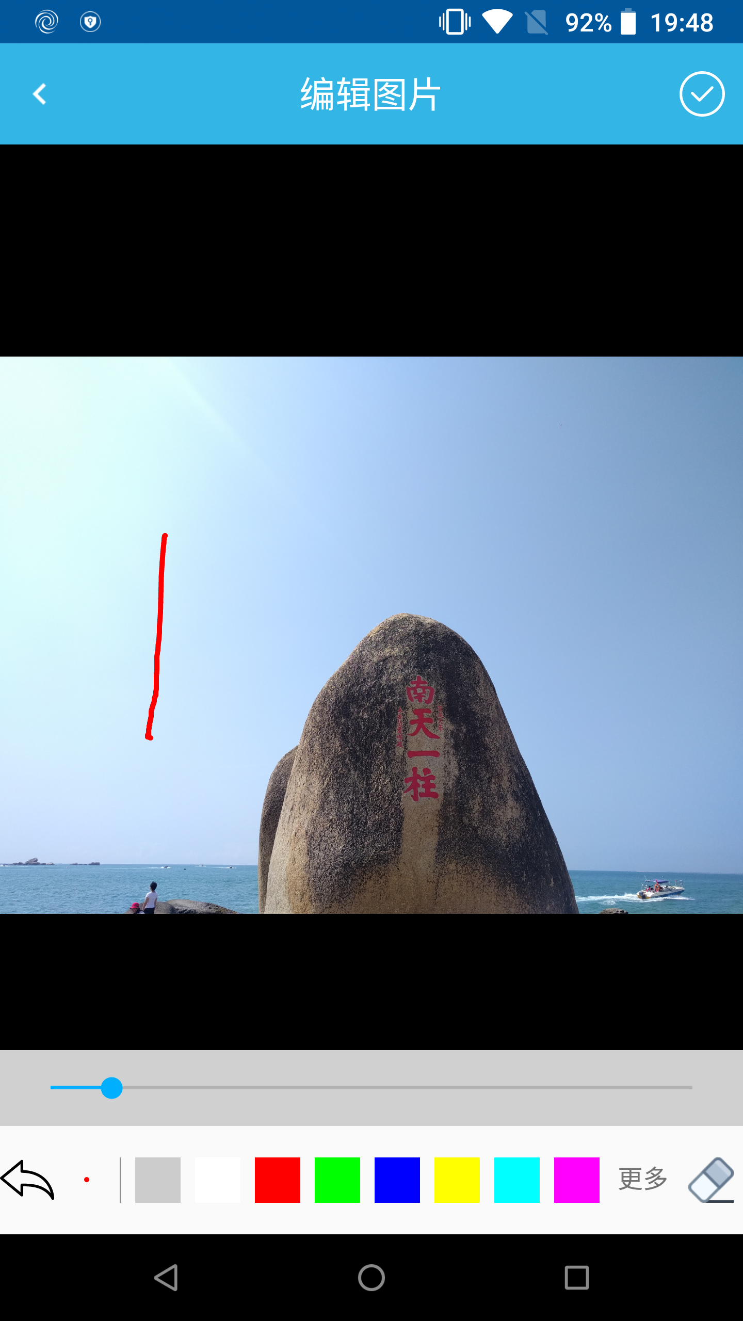
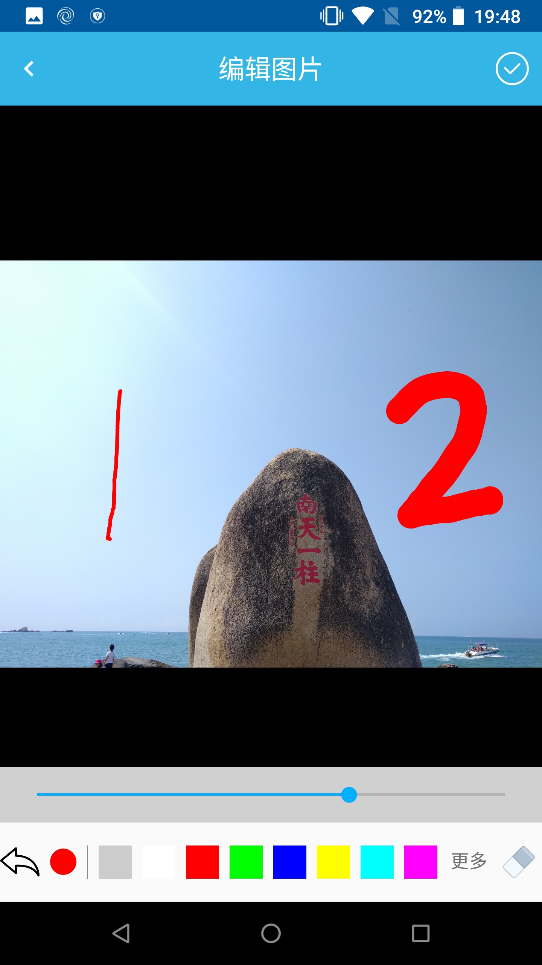

Slide 6
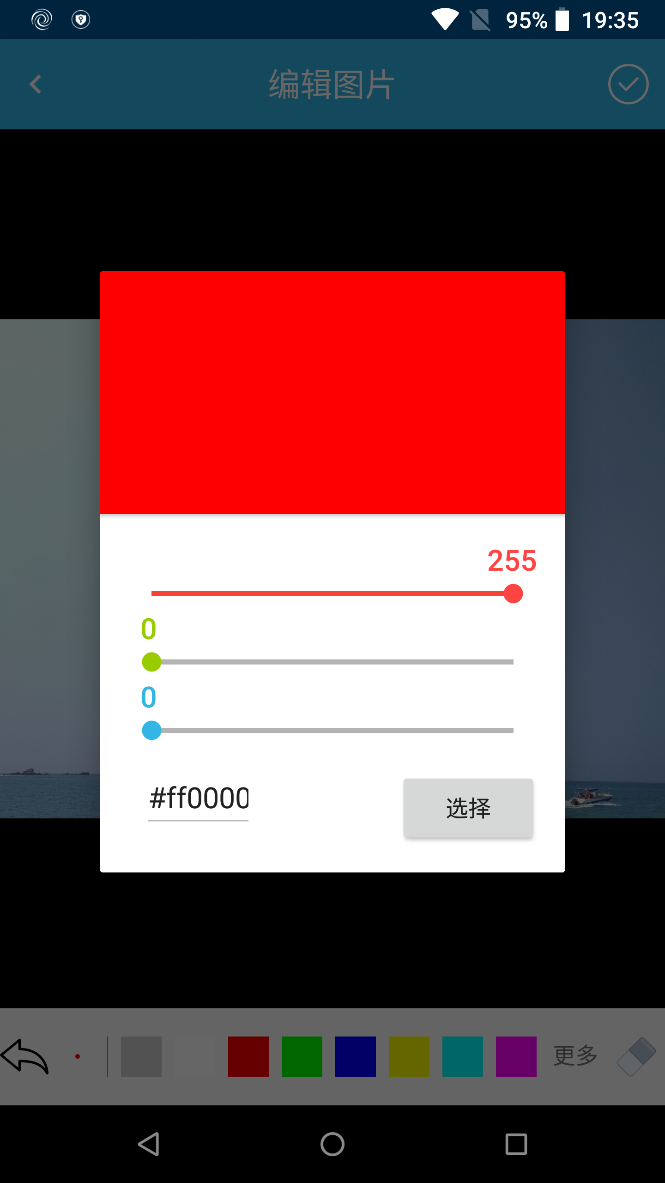
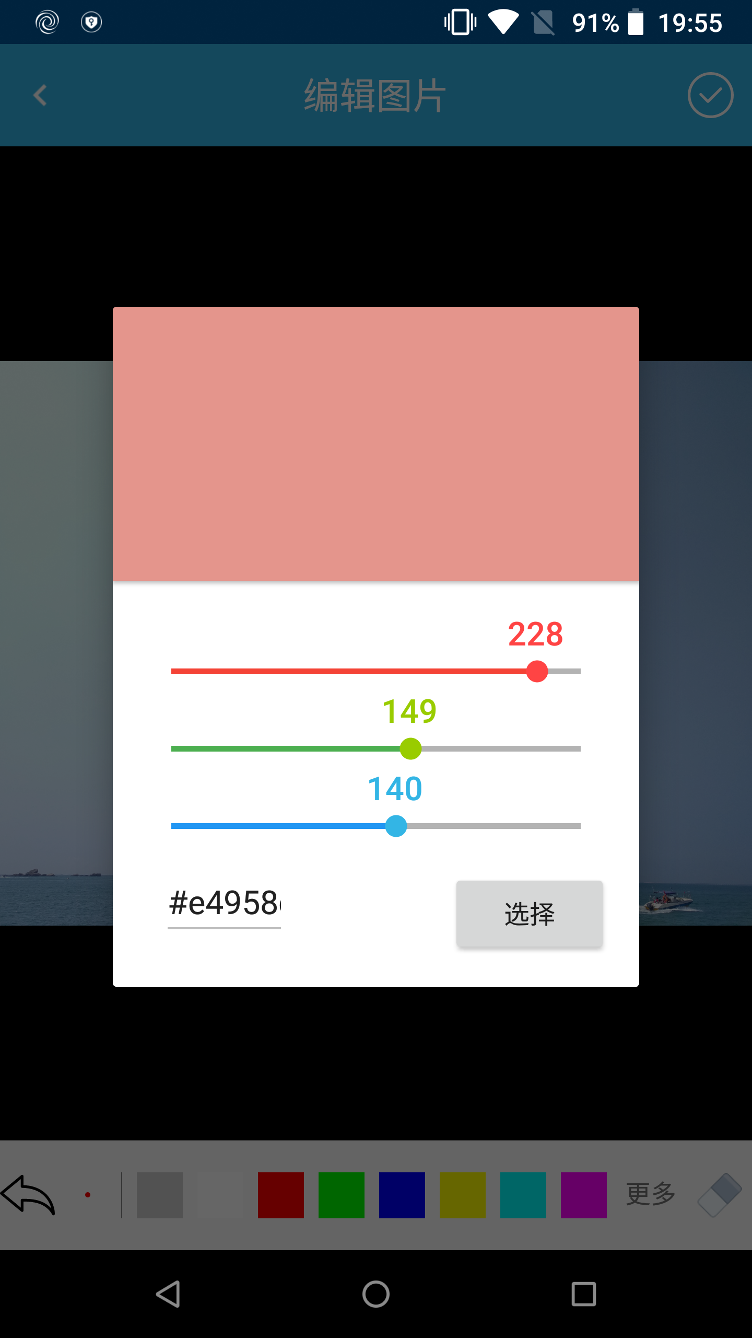

Slide 7
A
CustomPaintView
保存用户所画的线条
B
ImageView
为显示的原图信息

Slide 8
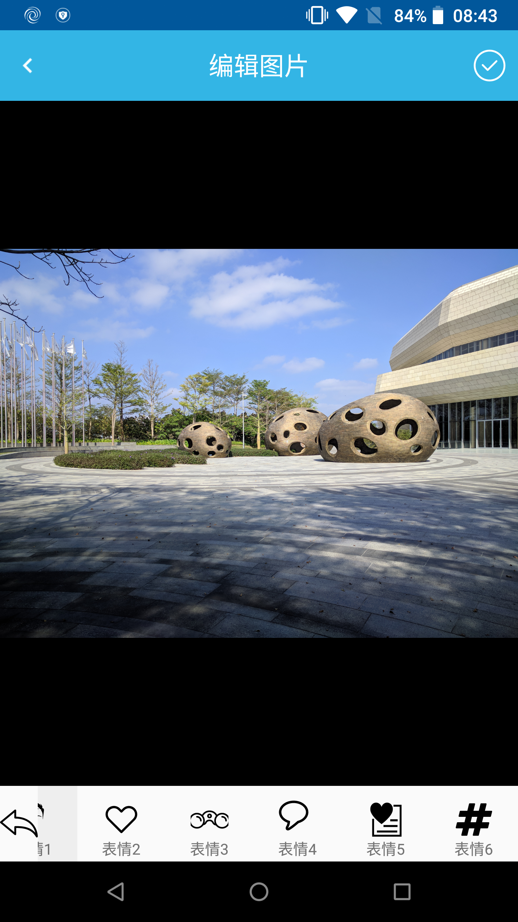
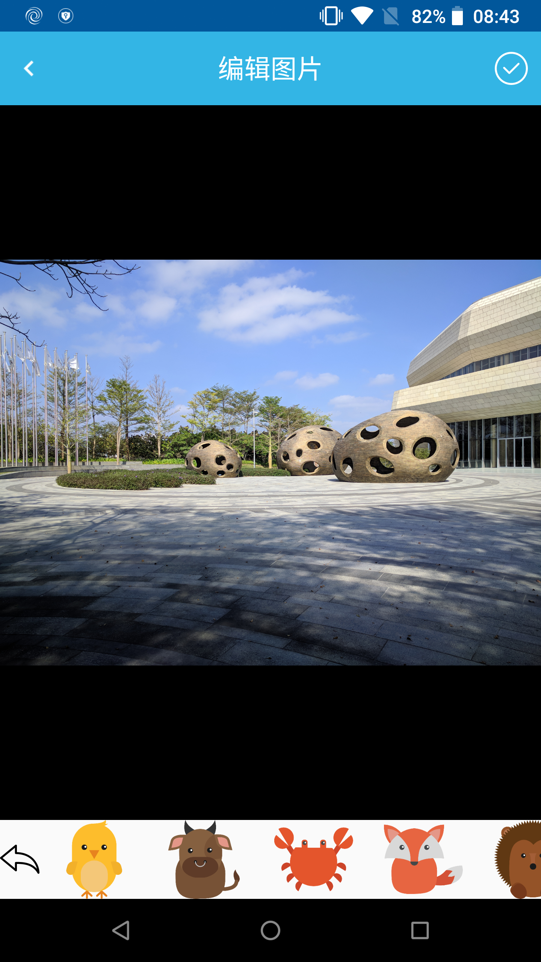
贴图选择菜单

